Slide 1

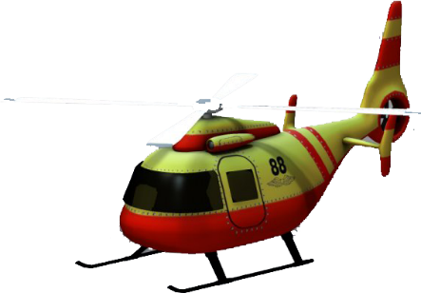
TUTORIAL
HELICOPTER
SAVE THE LIFE

Slide 2



TUTORIAL 1 & 2
HOLD ANYWHERE TO FLY UP
TILT THE LEFT OR RIGHT TO FLY FORWARD/BACKWARD
Make animation for the device tilt the left or right.
START
Building 2
Building 3
Building 1
Building 2
Building 3
Tutorial 1
Tutorial 2

Slide 3


TUTORIAL 3
HELICOPTER IS FULL. PLEASE DROP THE VICTIM TO THE RESCUE CENTER
The place to drop the victim.
After rescuing 2 victims, a pop-up display a message require the player drop the victim.
Building 1
Building 2
Building 3
Tutorial 3

Slide 4

WIRE FRAME 1
Air Balloon
UFO
Size: 150x190
Size: 160x100
Environment: City
Screen size: iPad - 1334 x 1002
Size: 150x80
Objects:
1 Helicopter
1 Air balloon
1 UFO
2 victims
Building 1
Hotel
Restaurant
Building 2
Street: Put some decoration as a few walkers , 2 – 3 vehicles, bicycle and trees…

Slide 5
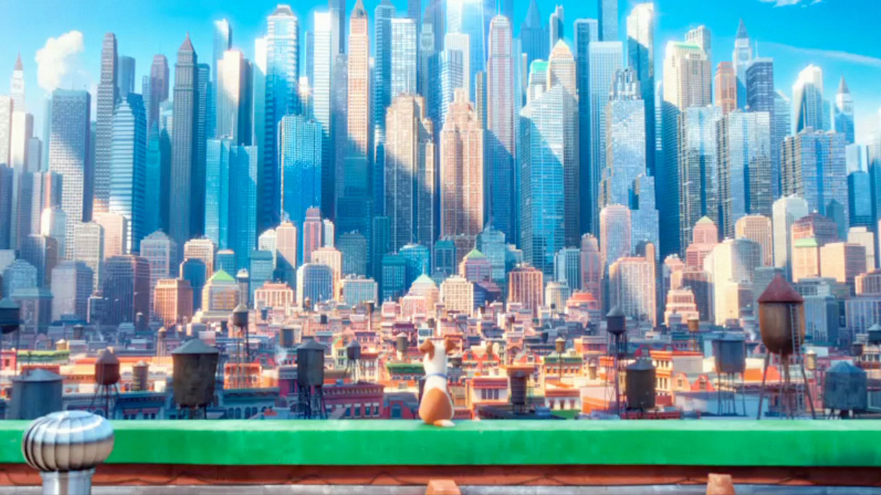
THANK YOU

